Slide 1
Cluster Validation Troubleshooting Tips
Carsten Hufe Senior Data Engineer
17. October 2017

Slide 2
Agenda
Cluster validation script; performing pre-installation tests
Why do we do this?
When should you do you use it?
What to look for?
Performing post-installation tests
Log files
GUTS
Log aggregation

Slide 3
Cluster validation scripts
What are they?
Why do we use them?
When should you use them?
What to look for?

Slide 4
Cluster validation scripts – What are they?
Cluster validation means enumerating and measuring characteristics of the hardware and software in your cluster using standardized testing methodology, so that you can:
Document / record the characteristics of your cluster
Check whether the configuration is what you expect
Check whether the configuration is consistent across “identical” nodes
Document / record baseline performance (providing a reference for later performance)
Compare with other documented results from other clusters
Identify and resolve any surprises or problems found by the tests
They can be found at: https://github.com/jbenninghoff/cluster-validation

Slide 5
Cluster validation scripts – Why do we use them?
In short, we use them to help identify any issues with the operating system, hardware or network. It also helps us document the “state” of the cluster before we ever even start a production use case or POC.
Suppose you’re doing a POC and skip cluster validation, perhaps because you feel pressed for time. What if a disk is slow, unbeknownst to you? That slow disk will negatively affect your application-level test results, but you won’t know it, because you didn’t take a baseline measurement of disk performance. Plus, once you have data loaded, you can’t really do a disk write test, because that destroys data.

Slide 6
Cluster validation scripts – When should we use them?
Cluster validation should be done at the beginning of every POC, as part of every installation of a customer cluster, and before any performance testing even if it’s only internal to MapR.
The only time you probably don’t need to validate a cluster is when you’re working internally only, and no one will ever care about performance on this cluster. For example, when you’re spinning up an EC2 cluster for a couple of days to test out a solution architecture at a functional level only. Even here, validation might be helpful.

Slide 7
Cluster validation scripts – What to look for?
Mismatch of CPUs/COREs
CPU/CORE running at different speeds
CPU/CORE missing
Mismatch of memory
Memory size differences
Memory clock speed differences
Memory bandwidth/performance differences
Mismatch of disks
Disks with different sizes
Disks with different controllers
Raid configurations
Disks with bandwidth issues
Disks with different technologies (SATA, SAS, SSD, NVMe)

Slide 8
Cluster validation scripts – Installing
Background: cluster-audit.sh is designed for physical servers. Virtual Instances in cloud environments (eg Amazon, Google, or OpenStack) may generate confusing responses to some specific commands (eg dmidecode). In most cases, these anomalies are irrelevant.
Some customer have issues with installing from EPEL repositories, ask them if they do.
On your own EC2 Instance following the lab exercise to install cluster validation scripts.

Slide 9
Pre-validation

Slide 10
What happened when you tried to install?
What error did you see/get?
Why is this important?
Proxy/firewall issues come up in larger account. Watch out for:
Customers that have a firewall or proxy
Ensure that the customer has a valid proxy server or firewall configuration were we can get out an install packages from repositories
Some customers may be large enough to have their own RHEL Satellite servers (internal package manager servers). We do have ways to work with these but will have to reach out to the MapR Field Engineering Team.

Slide 11
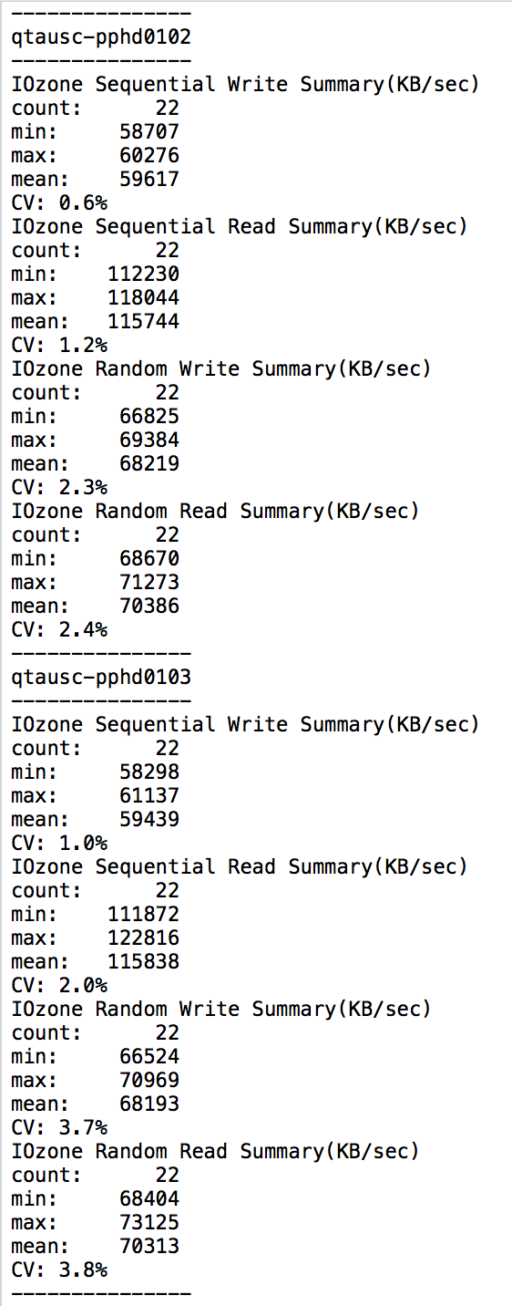
Cluster validation scripts – Examples
Here is an example of poor disk write performance using the:
clush –ab /root/cluster-validation/pre-install/disk-test.sh
clush -ab /root/cluster-validation/pre-install/summIOzone.sh
Current generation (2012+) 7200 rpm SATA drives can produce 100-145 MB/sec sequential read and write performance.

Slide 12
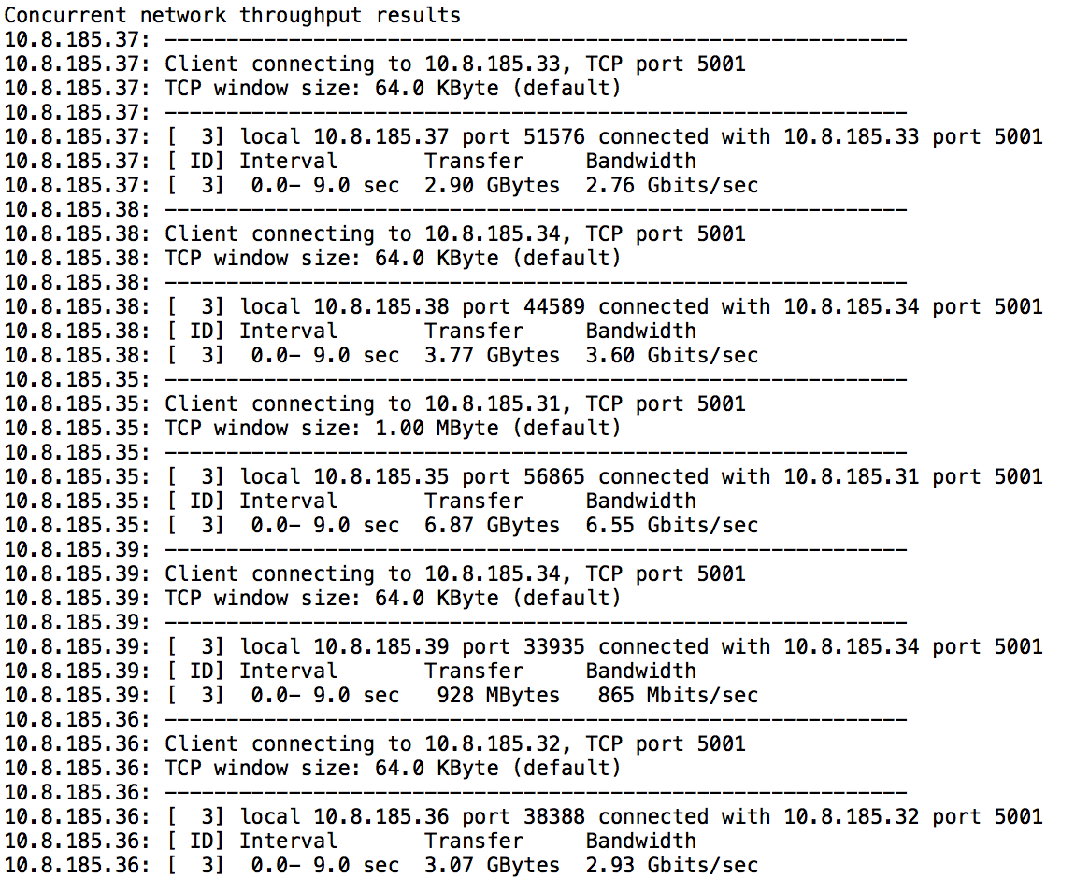
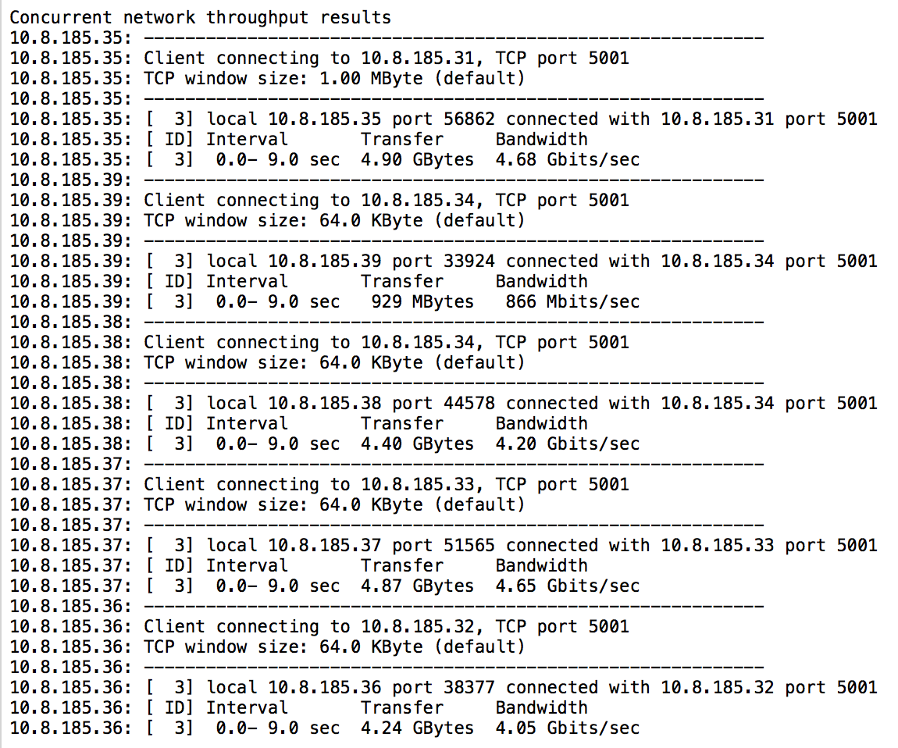
Cluster validation scripts – Examples
Here is an example of poor network performance using the:
/root/cluster-validation/pre-install/network-test.sh | tee network-test.log
Expect about 90% of peak bandwidth for either 1GbE or 10GbE networks:
1 GbE ==> ~115 MB/sec
10 GbE ==> ~1150 MB/sec

Slide 13
Why is network speed important?
Provide a good performance for non-local reads
Replication is a synchronous action, when data is written it gets directly written to two other nodes
Fast local
write
1 Gbit NIC
~ 110 MB/s
1 Gbit NIC
~ 110 MB/s
Data
Node 1
(Master)
Node 2
(Replica)
Node 3
(Replica)
Replicate
Replicate
Assumption: A node has 12 disks inside with a cumulated write speed of 2000 MB/s.
1 Gbit NIC can only provide ~110MB/s, this means 95% of speed cannot be utilized when using replication higher than 1. Network should have 20 Gbit NICs, these can reach around 2200 MB/s.

Slide 14
Post-validation

Slide 15
Performing post-install cluster validation tests
Typically used for validating all services are working
Test | Description
TeraSort MapReduce | Uses MapReduce to generate and sort data
TeraSort Spark | Uses Spark to generate and sort data
DFSIO | Cluster write and read performance measured with Map-Reduce. By default creates one file per cluster disk.
RunRWSpeedtest | Measure performance of local and standard volumes from a local process.
YCSB | Benchmark MapR-DB

Slide 16
Log files

Slide 17
Most Important Log files
Component | Type Of Log | Log file
CLDB | Main | /opt/mapr/logs/cldb.log
Warden | Main | /opt/mapr/logs/warden.log
MapR-Fileserver | CLDB connection initialization | /opt/mapr/logs/mfs.log-0
MapR-Fileserver | MapR-FS | /opt/mapr/logs/mfs.log-3
MapR-Fileserver | MapR-DB | /opt/mapr/logs/mfs.log-5
NFS server | Main | /opt/mapr/logs/nfsserver.log
Gateway | Main | /opt/mapr/logs/gateway.log
Tools | Configure.sh | /opt/mapr/logs/configure.log
Tools | disksetup | /opt/mapr/logs/disksetup.<uid>.log
Tools | Disk failures | /opt/mapr/logs/faileddisk.log

Slide 18
Most Important Log files
Component | Type Of Log | Log file
ResourceManager | Main | /opt/mapr/hadoop/hadoop-<version>/logs/yarn-mapr-resourcemanager-<hostname>.log
NodeManager | Main | /opt/mapr/hadoop/hadoop-<version>/logs/yarn-mapr-nodemanager-<hostname>.log
Zookeeper | Main | /opt/mapr/zookeeper/zookeeper-3.4.5/logs/zookeeper.log
Complete list: https://maprdocs.mapr.com/52/ReferenceGuide/MapRLogs.html

Slide 19
GUTS

Slide 20
GUTS tool
GUTS tool can be found in /opt/mapr/bin/guts. It can be executed on the node on which we wish to get performance stats. Running guts without any options will show a set of metrics as below.
$ /opt/mapr/bin/guts
00 01 02 03 rpc write lwrite read lread icache dcache di ic dd dc ior iow
61 40 61 59 9 0 0 0 0 0 0 0 0 0 0 0 0 0 0 0 41 0 0 4 0
78 30 74 73 21 0 0 0 0 0 0 0 0 0 0 0 0 0 0 14 0 0 24 0

Slide 21
GUTS tool
Field | Description
CPU stats | First line 00, 01, 02 & 03 are the CPU numbers, values are remaining CPU idle time
Rpc | Number of RPC calls
write | Remote writes in #RPC and #MB
lwrite | Local writes in #RPC and #MB
read | Remote reads in #RPC and #MB
lread | Local reads in #RPC and #MB
icache | Inode cache #lookups and #misses
dcache | Block cache #lookups and #misses

Slide 22
GUTS tool
Field | Description
di | #inodes dirtied by update ops
ic | #inodes cleaned by drainer
dd | #blocks dirtied by update ops
dc | #blocks cleaned by drainer
ior | Io reads #operations, #MB
iow | Io writes #operations, #MB

Slide 23
YARN Log aggregation

Slide 24
YARN Log aggregation
The YARN Log Aggregation option aggregates and moves log files for completed applications from the local file system to the MapR-FS. This allows users to view the entire set of logs for a particular application using the HistoryServer UI or by running the yarn logs command.
By default, YARN container logs are not aggregated on the MapR-FS. Instead, the logs are retained for 3 hours on the local file system before they are deleted.

Slide 25
Enable YARN Log aggregation
Add following to /opt/mapr/hadoop-2.7.o/etc/hadoop/yarn-site.xml
<property> <name>yarn.log-aggregation-enable</name> <value>true</value> </property>
Restart YARN services.

Slide 26
View logs for completed applications
Determine the application ID for the application that you want to view the logs for. For example, run the following command to list the applications:
$ yarn application -list
Run the yarn logs command to view the logs for the application. For example, run the following command to view the log files for application application_1415822090718
$ yarn logs -applicationId application_1415822090718

Slide 27



Questions?
Q&A
Carsten Hufe
Senior Data Engineer
chufe@mapr.com

